Slide 1
Introduction to Julia
A programming language for scientific computing

Slide 2
Content
What is Julia?
Why Julia?
Python vs Julia
What makes Julia fast?

Slide 3
What is Julia?
In a Nutshell:
Julia is a fast programming language, designed from the ground for high performance.
Julia is dynamically typed, it feels like a scripting language and has great support for interactive use.
Julia is reproducible, having a built-in package manager and being available across a wide range of platforms.
Julia is Open Source – under the MIT license.

Slide 4
Why Julia?
High performance – approaches speeds similar to C or Fortran and is the only dynamic language which has broken the petaflop barrier (along with C/C++ and Fortran).
Easy to learn – simple syntax similar to MATLAB and Python.
Built with support for threading and distributed computing in mind. It is trivial to scale from your laptop to a high performance cluster.
Fast growing language – becoming increasingly popular in numerical computing
Large ecosystem of packages, particularly for numerical computing, with support for linear algebra built into the language.

Slide 5
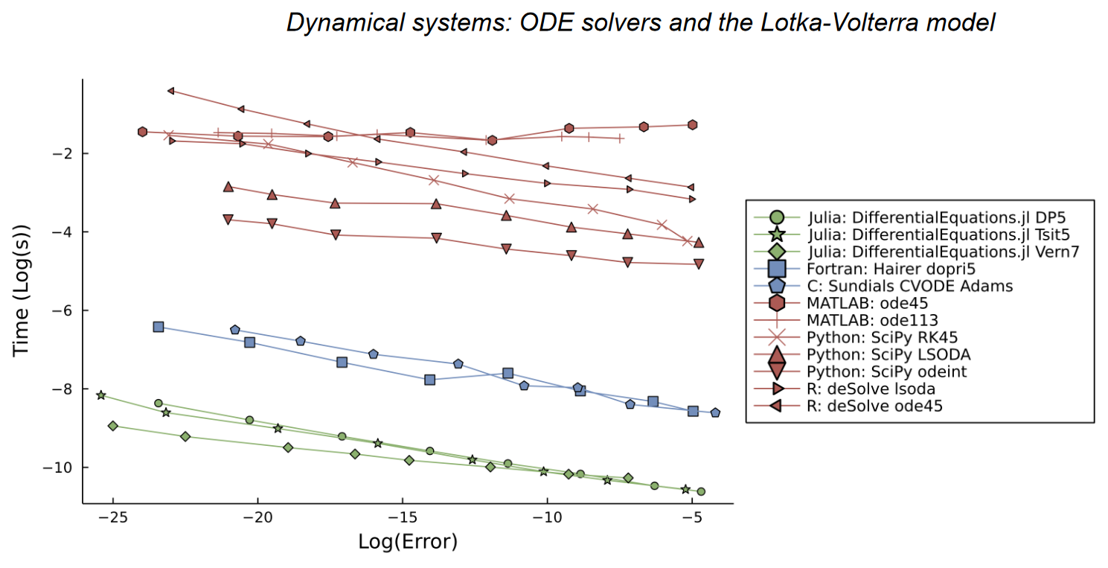
Performance in DifferentialEquations.jl
Julia for Biologists: https://arxiv.org/abs/2109.09973

Slide 6
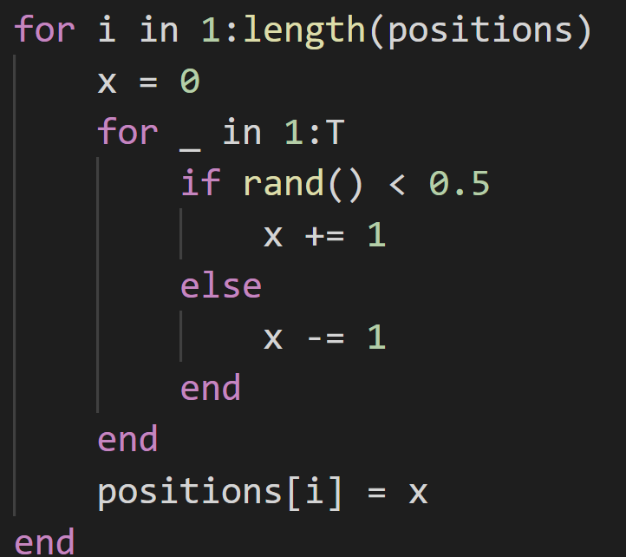
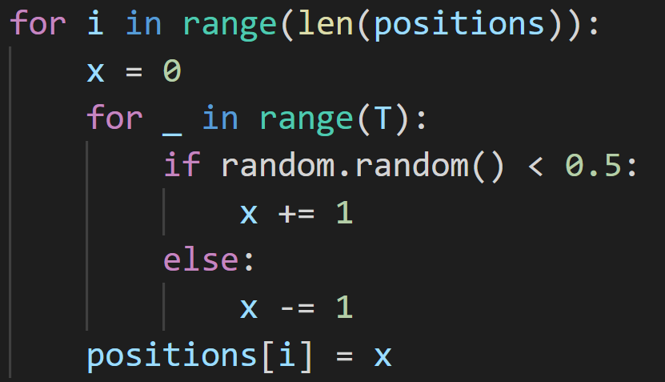

Python vs Julia – Random Walk benchmark
Julia:
Python:
$$N=2^{10}$$
$$T=100$$
10355.7 μs
351.900 μs
Julia is around 30 times faster here

Slide 7
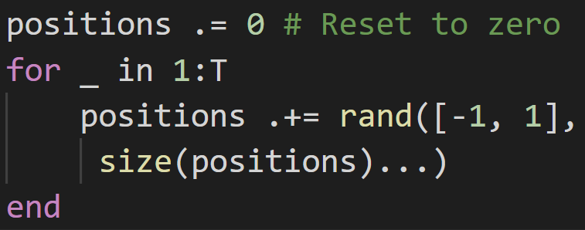
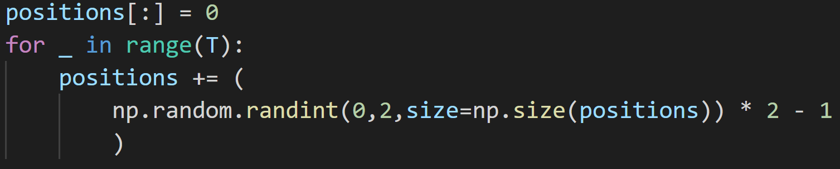

Python vs Julia – Random Walk w/ Arrays
521.900 μs
Julia:
2127.4 μs
Python:
$$N=2^{10}$$
$$T=100$$
Julia is only around 4x faster here, but numpy implementation could be better

Slide 8
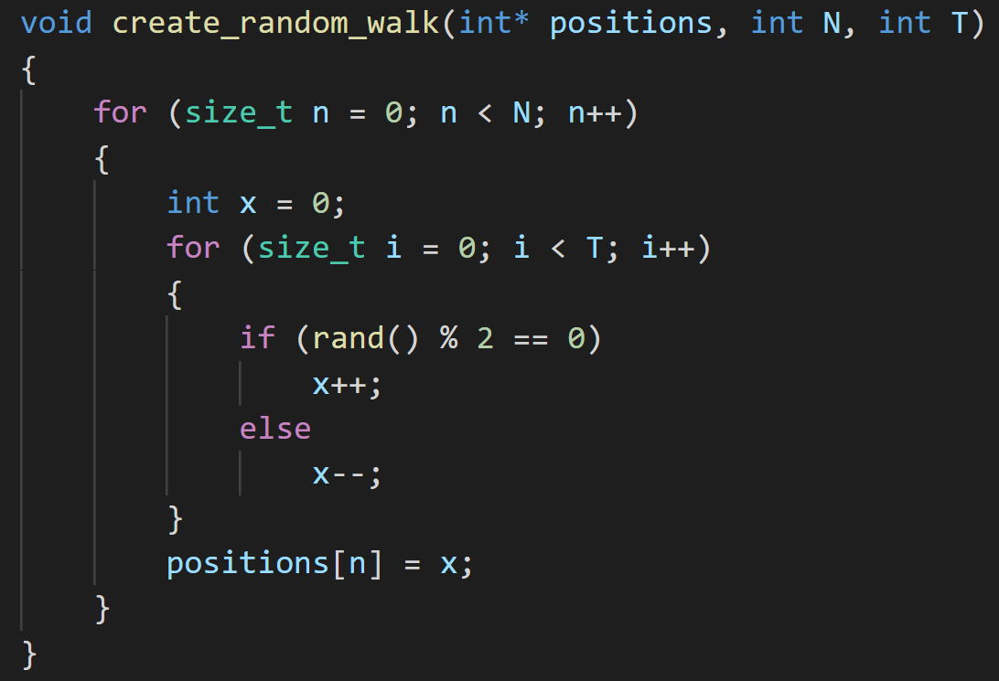
C++ vs Julia – Random Walk benchmark
Julia:
C/C++:
$$N=2^{10}$$
$$T=100$$
996 μs
351.900 μs
Julia is around 2.8 times faster here

Slide 9
Why is Julia fast?
Just-in-Time compiled, which specialises on the types of the variables.
Compiler tries to perform many optimisations, such as Single Instruction Multiple Data (SIMD) commands which most modern CPUs support.
Only fast if type stable!

Slide 10
So what?

Slide 11
Interesting reasons to try Julia
Has generic code that works across packages
Designed from the ground up for numerical computing
Linear-algebra is implemented natively.
Full Unicode support – write your functions as native equations!
Full support for metaprogramming – code that writes code.
Packages are easy to use with a very helpful community.

Slide 13
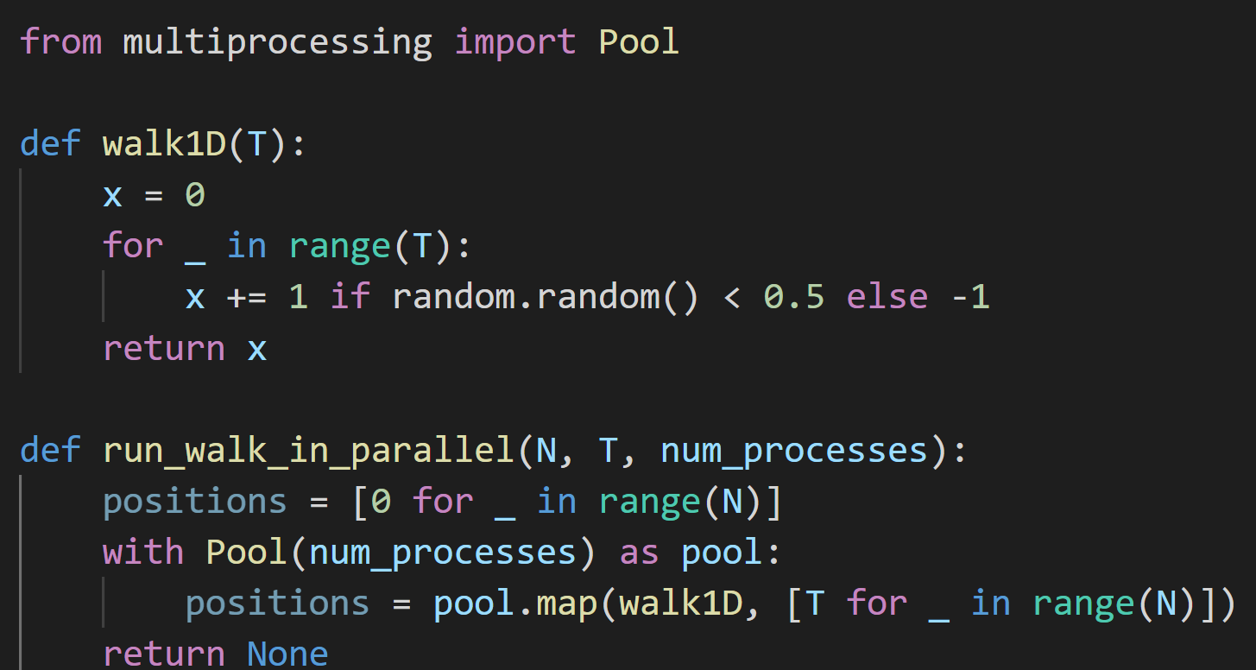

Python vs Julia – Random Walk in Parallel
Python:
$$N=2^{20}$$
$$T=100$$
1030ms

Slide 14
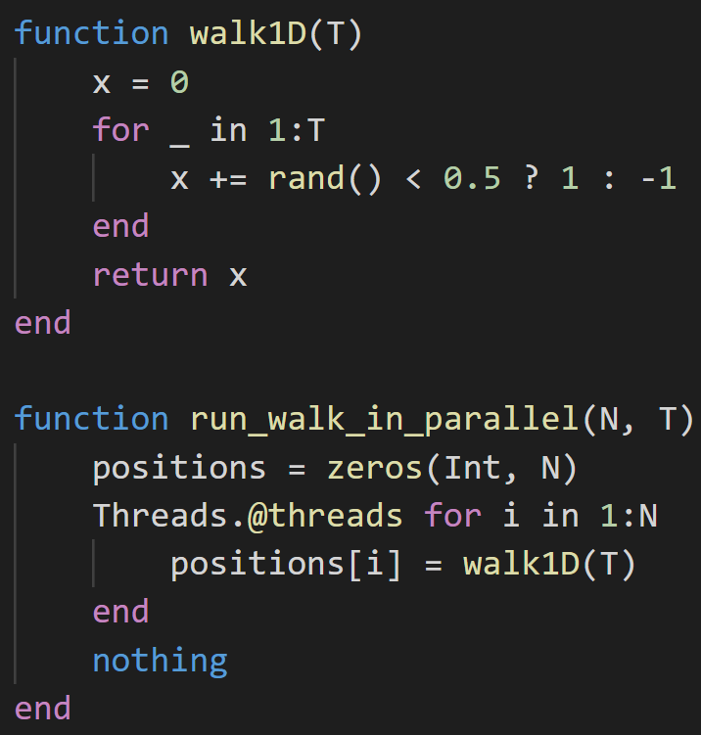

Python vs Julia – Random Walk in Parallel
Julia:
~40 times faster than in Python.
$$N=2^{20}$$
$$T=100$$
25.16ms

Slide 15
What makes Julia fast? – Type System

